Slide 1




Lebanese Football Association Soccer Database
AMERICAN UNIVERSITY OF SCIENCE AND TECHNOLOGY
FACULTY OF ARTS AND SCIENCES / ENGINEERING
Presented by:
Peter ABou Ghannam : 22230066
Robert Abou Nader: 22130054
Mohamad Ali El Bakawi : 22230060
Marc Elio Awad : 22130091

Slide 2
Lebanese Football Association Soccer Database
Introduction
Design
Forms and Reports
Scrapper
2

Slide 3


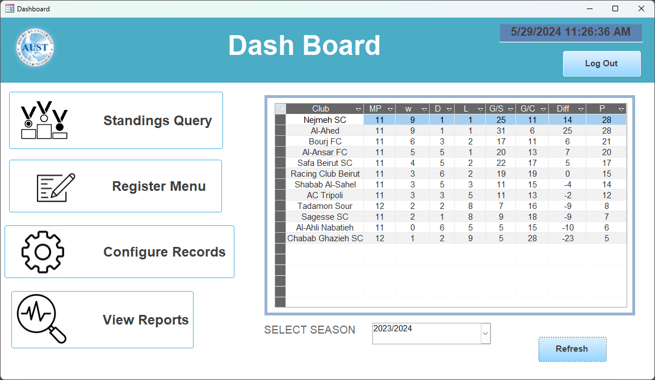
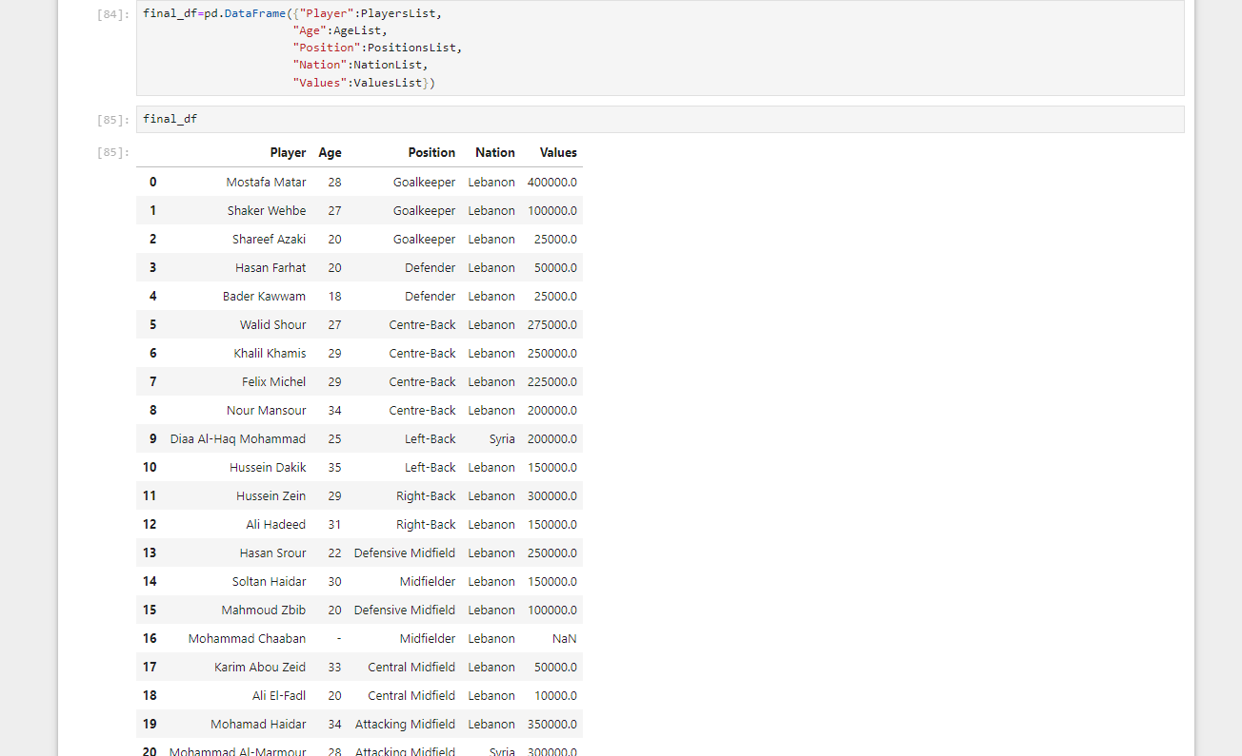
Lebanese Premier League, is the top division of the Lebanese football league system. There are 12 teams competing in the league
Project Structure
3
Notes:
This Project aims to document everything in the Lebanese premiere league and produce insightful reports and stats
[O2RA SLIDE TEXT]
Access Database, with an Interactive GUI based on forms.
Python Scraper to assist in the data entry using Jupyter’s Notebook.

Slide 4
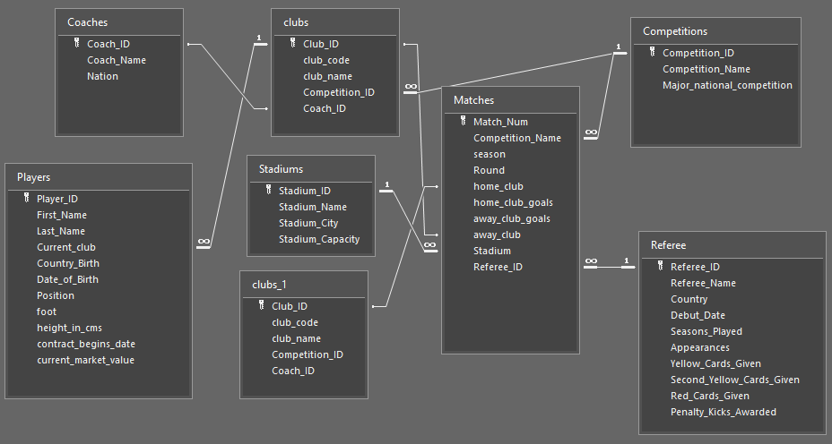
Relationships and tables
ONE TO ONE
ONE TO MANY
4
Notes:
Each club has many players and one optional coach, but a player can only be in one club.
Matches belong to one competition and are hosted by one referee in one stadium, with each referee and stadium hosting multiple matches.
Home and away clubs in each match are unique.

Slide 5
Validation rules
normalization
Is Not Null
First Normal Form (1NF):
atomic values and single-type columns only are used.
Second Normal Form (2NF):
1NF + full functional dependency on the primary key.
Third Normal Form (3NF):
2NF + no non-key column depends on another non-key column.
Is Not Null And Not Like "*[!a-zA-Z0-9]*"
Is Not Null And [Date_of_Birth]<Date() And [Date_of_Birth]>DateAdd("yyyy",-100,Date())
Not Like "*[0-9!@#\$%^&*()_+{}|<>?/~]*"
Is Not Null And [height_in_cms]>=100 And [height_in_cms]<=250
4th NF was not implemented because it increases tables and slow queries.
Is Not Null And Not Like "*[@#\$%^&*()_+{}|<>?/~]*" And >=0
5
Notes:
For validation, we used rules on the tables and on the forms excessively, and many input masks.
All Fields in tables and Forms output corresponding text when a validation issue occurs.
Is Not Null And Not Like "*[!a-zA-Z0-9]*“
only letter and numbers
Is Not Null And [Date_of_Birth]<Date() And [Date_of_Birth]>DateAdd("yyyy",-100,Date())
Birth date is not in the future and not older than last 100 years
Not Like "*[0-9!@#\$%^&*()_+{}|<>?/~]*“
no number from 0-9 and special symbols
Is Not Null And [height_in_cms]>=100 And [height_in_cms]<=250
Height must be reasonable
Is Not Null And Not Like "*[@#\$%^&*()_+{}|<>?/~]*" And >=0
only number, no symbols and positive
[o2ra el normalization part]

Slide 6

FoRMs
Dashboard Menu:
Buttons, that opens Sub-Menus
Logout Button
Sub Form that is connected to Standings Query for the Lebanese Premire League, With a selection of Parameters Features
Login Form, non closable, not movable, cant access database without entering correct information
6

Slide 7
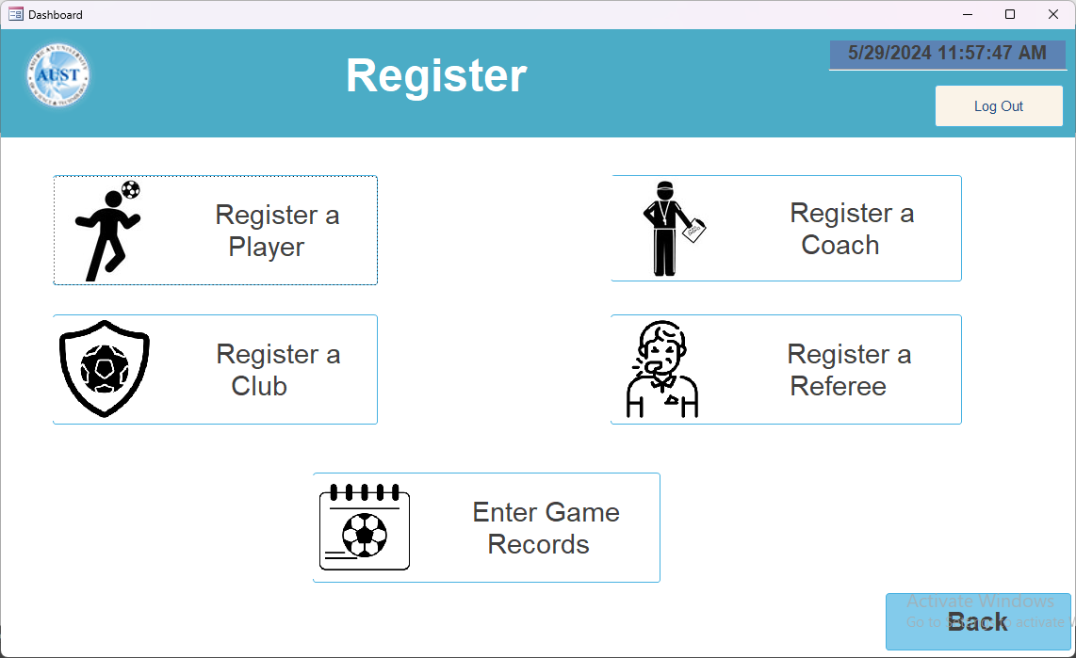
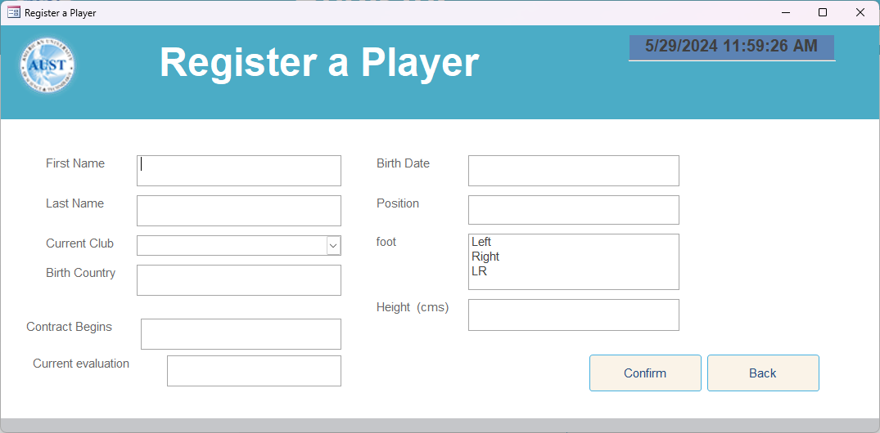
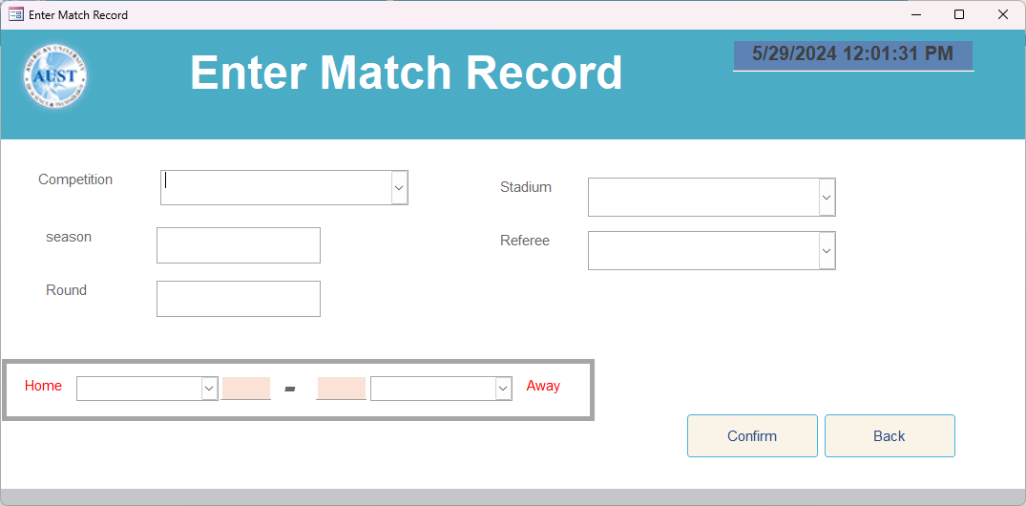
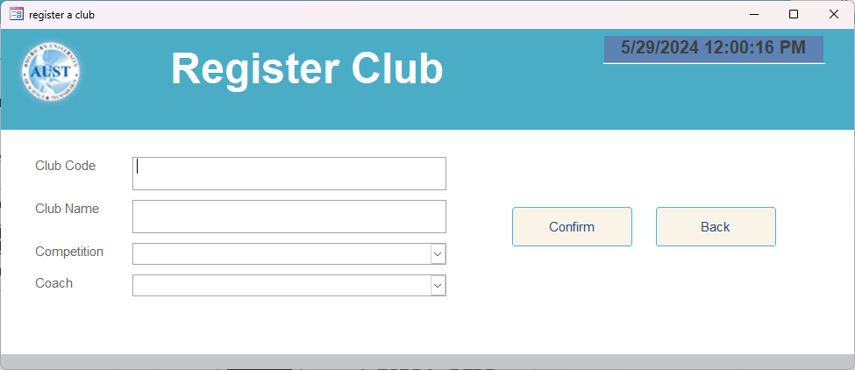
7

Slide 8
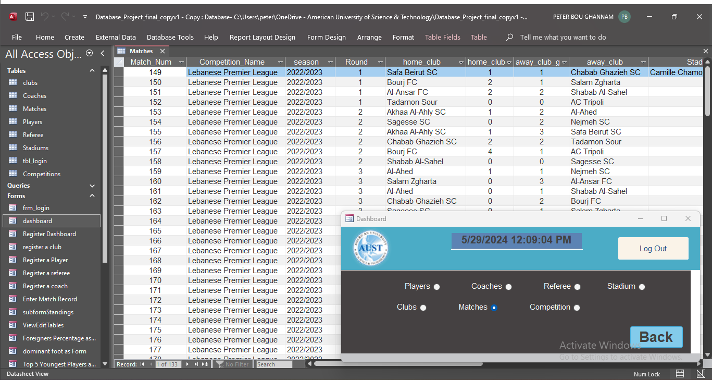
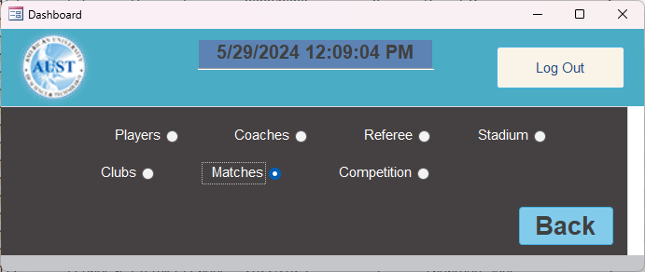
Acts as navigation menu between the tables, so the user can take a quick look at the tables and records available, this form importance is to handle errors and popups which are caused by opening multiple tables at once.
And since validation exists on both the Forms, and tables, the admin can also edit them with full integrity.
8
Notes:
[read text on slide]
Each radio Button when clicked opens a Table in datasheet View, and since all the radio Buttons are in a group, only one can be opened at a time.
When unclicked automatically after another radio button is clicked, the table is closed and saved.

Slide 9
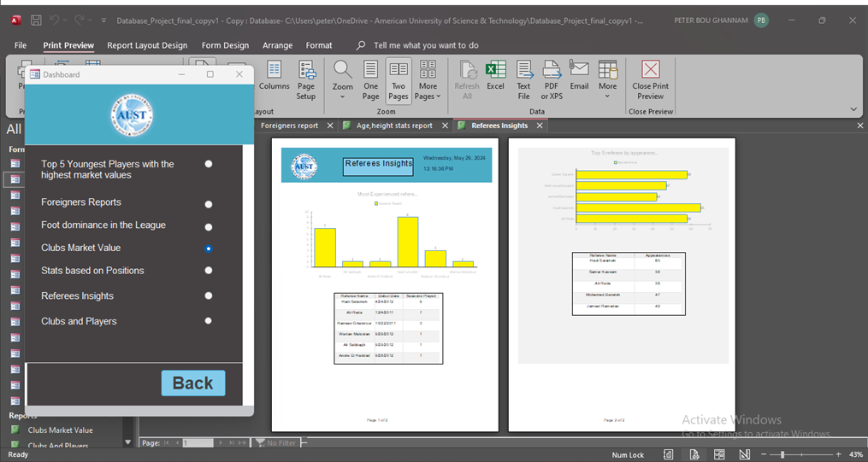
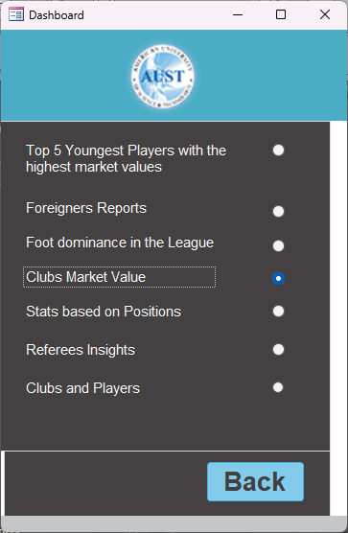
acts as navigation menu between one to many reports, opens each report in print View.
When back button is clicked we return to the dashboard.
9

Slide 10
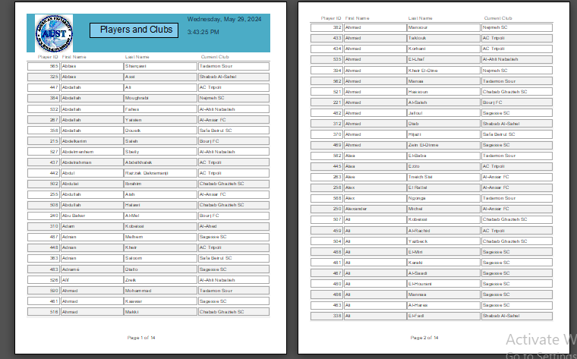
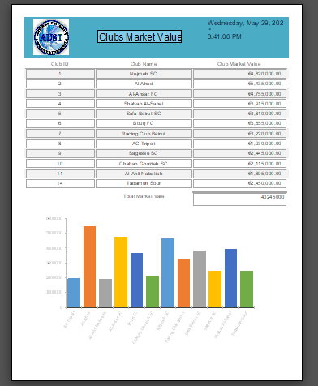
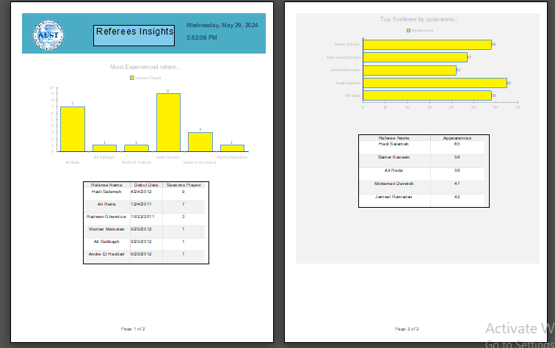
reports
Players and Clubs
Club Market Value
Referee Insights
And more to show during the program execution…

Slide 11
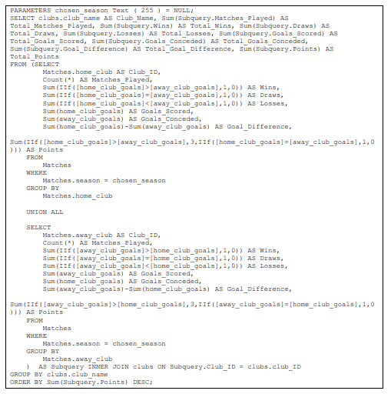
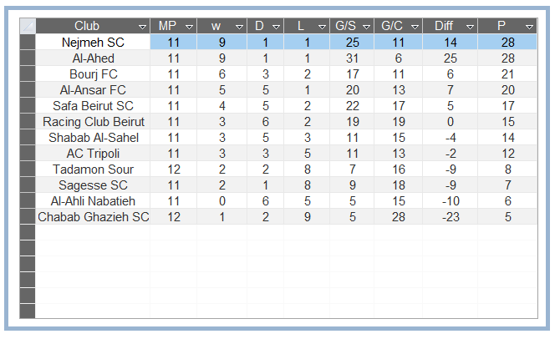
Important Queries used
Standings Query
This query generates the standings of football clubs for a specific season based on match results. It includes the total number of matches played, wins, draws, losses, goals scored, goals conceded, goal difference, and points for each club.
Notes:
Steps Involved
Parameters
chosen_season: The season for which we want to see the standings.
Subquery 1: Home Matches
Selects home_club as Club_ID.
Counts total matches played at home.
Sums wins, draws, and losses based on home match results.
Sums goals scored and conceded by the home club.
Calculates goal difference and points for home matches.
Subquery 2: Away Matches
Similar to Subquery 1 but for away_club.
Counts total matches played away.
Sums wins, draws, and losses based on away match results.
Sums goals scored and conceded by the away club.
Calculates goal difference and points for away matches.
Union of Subqueries
Combines results from both home and away subqueries.
Groups by Club_ID.
Main Query
Joins the unioned subquery results with the clubs table on Club_ID.
Groups by club_name.
Sums total matches played, wins, draws, losses, goals scored, goals conceded, goal difference, and points.
Orders the results by total points in descending order.

Slide 12
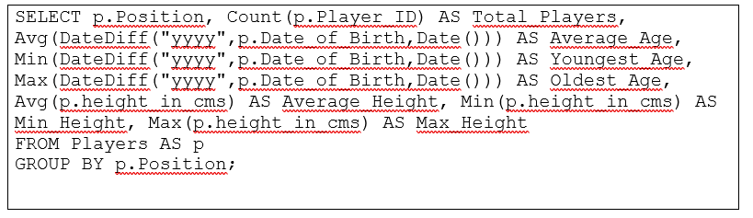
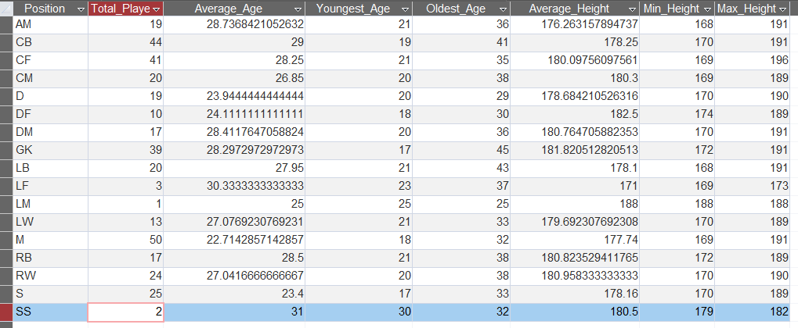
Position Study
This query calculates and summarizes various statistics for football players, grouped by their playing positions. It includes the total number of players, average age, youngest and oldest player ages, and height statistics (average, minimum, and maximum) for each position.
Notes:
Steps Involved
Parameters and Functions
DateDiff("yyyy", p.Date_of_Birth, Date()): This function calculates the difference in years between a player's date of birth and the current date, effectively computing the player's age.
Select Clause
p.Position: Selects the position of the player.
Count(p.Player_ID) AS Total_Players: Counts the total number of players for each position.
Avg(DateDiff("yyyy", p.Date_of_Birth, Date())) AS Average_Age: Calculates the average age of players for each position.
Min(DateDiff("yyyy", p.Date_of_Birth, Date())) AS Youngest_Age: Finds the age of the youngest player for each position.
Max(DateDiff("yyyy", p.Date_of_Birth, Date())) AS Oldest_Age: Finds the age of the oldest player for each position.
Avg(p.height_in_cms) AS Average_Height: Calculates the average height of players for each position.
Min(p.height_in_cms) AS Min_Height: Finds the minimum height of players for each position.
Max(p.height_in_cms) AS Max_Height: Finds the maximum height of players for each position.
From Clause
Players AS p: Specifies the table (Players) and its alias (p) from which to retrieve data.
Group By Clause
p.Position: Groups the results by the position of the players to calculate the aggregated statistics for each position.

Slide 13
Scraper
The scrapper was only built to fetch and scrap data from some Html pages in https://www.transfermarkt.com/
Purpose:
help with getting real accurate data during the development of the database
written using python
on Jupyter Notebook
A Jupyter Notebook has two components:
a front-end web page
back-end kernel.
Notes:
Jupyter Notebook is an interactive web application for creating and sharing computational documents, combining code, narrative text, equations, and visualizations.
the front-end web page allows data scientists to enter programming code or text in rectangular "cells." The browser then passes the code to the back-end kernel which runs the code and returns the results

Slide 14
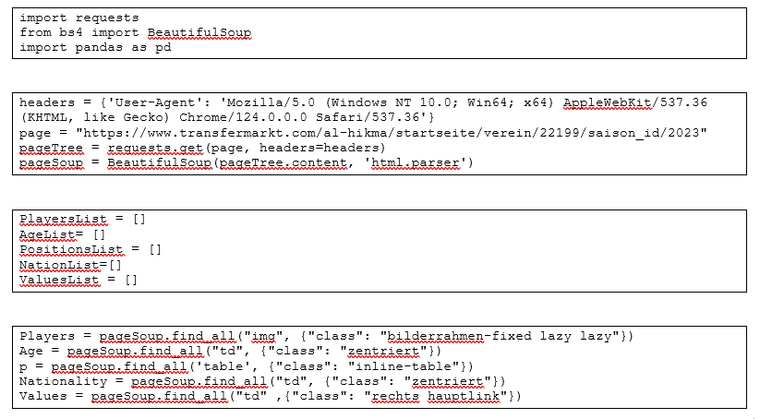
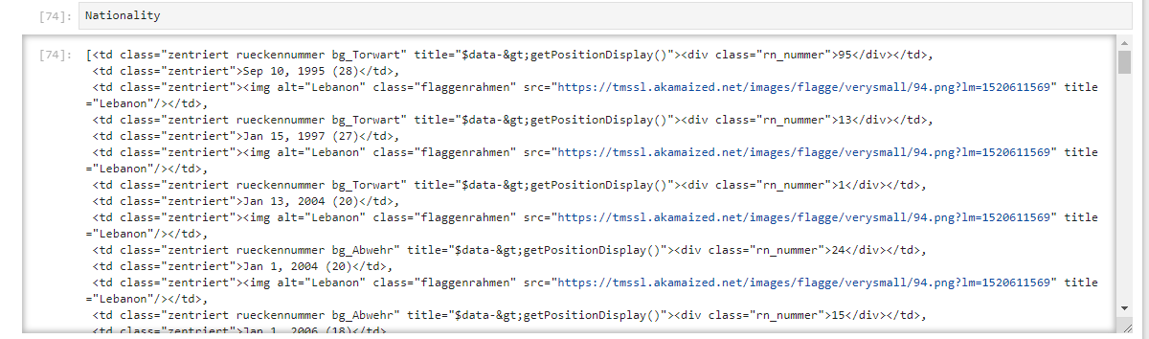
Notes:
import requests:
This imports the requests library, which is used to send HTTP requests in Python. It allows you to fetch the content of web pages.
from bs4 import BeautifulSoup:
This imports the BeautifulSoup class from the bs4 (Beautiful Soup) library, which is used for parsing HTML and XML documents. It helps in extracting data from web pages in a hierarchical and readable manner.
import pandas as pd:
Pandas is a powerful data manipulation and analysis library in Python. It provides data structures like DataFrames that are useful for handling and analyzing structured data.
Set Headers:
Sets a custom User-Agent header to mimic a real web browser.
(here I used my real user agent, Peter Bou Ghannam)
Define the Page URL:
Specifies the URL of the web page to scrape.
pageTree = requests.get(page, headers=headers)
Sends an HTTP GET request to the URL with the custom headers.
pageSoup = BeautifulSoup(pageTree.content, 'html.parser')
Parses the HTML content of the fetched page using BeautifulSoup.
Next we create arrays to hold information
Fourth cell
. It finds and stores these elements based on their respective HTML tags and classes for further processing.

Slide 15
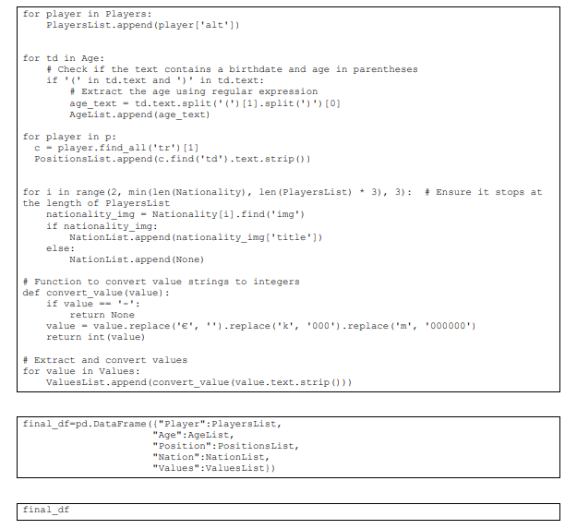
Data Frame Output

Slide 16


